Slide 1


Heart Disease Detection
CP322 Project By:
Zaina Basit Alavi
Ozair Khan

Slide 2

Agenda:
Introduction
Project Description
Methodology
Results and Analysis
Conclusion

Slide 3
Abstract
Heart failure is a leading cause of death globally.
Many patients are unaware of their heart disease, leading to vulnerability.
Machine learning can automate diagnosis, improving accuracy and reducing costs.
The project will use supervised binary classification for heart disease diagnosis.

Slide 4

Introduction
The heart controls blood flow throughout the human body and is a vital organ.
Issues with the cardiovascular system can result in sudden death by heart failure.
Factors such as smoking, unhealthy lifestyle and alcohol can contribute to heart diseases.
The project aims to train a supervised classification model to detect heart disease.
Logistic Regression and K-Nearest-Neighbors are the two machine learning models used.
The models will be compared for accuracy, and the better model will be chosen as the heart disease classifier.

Slide 5
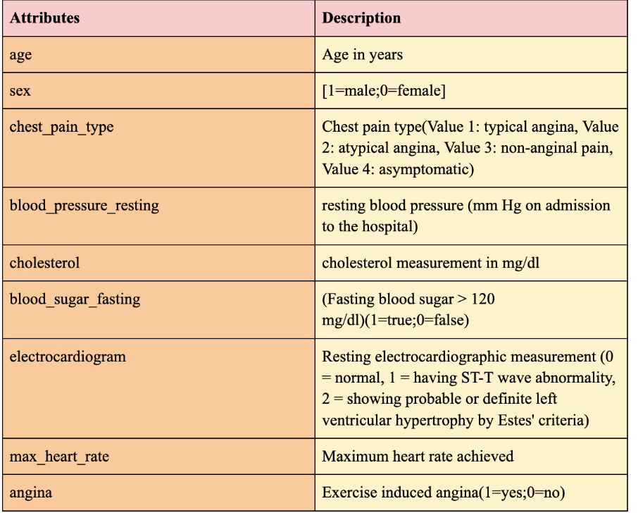


Project Description:
Data Collection
URL:https://www.kaggle.com/datasets/johnsmith88/heart-disease-dataset

Slide 6

Exploratory Data Analysis:
Refers to the process of investigating data through summary statistics and visualizations
The investigation aimed to analyze the distribution tally of heart detection and identified that detected heart disease exceeded undetected heart disease. (Figure 1)
Females had more detected cases of heart disease than males (Figure 2)
The correlation matrix (Figure 3) revealed that variables such as target, chest_pain_type, max_heart_rate, and angina have a strong positive correlation with heart disease.

Slide 7
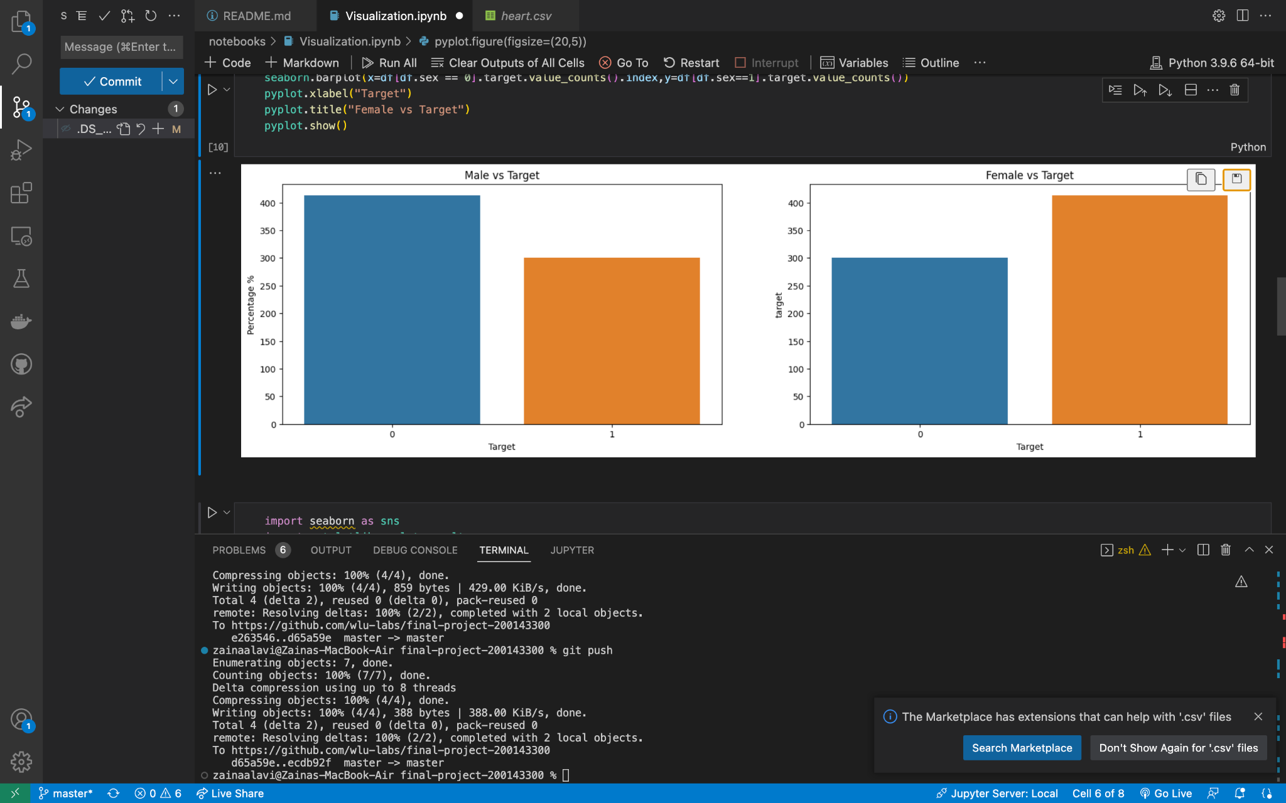
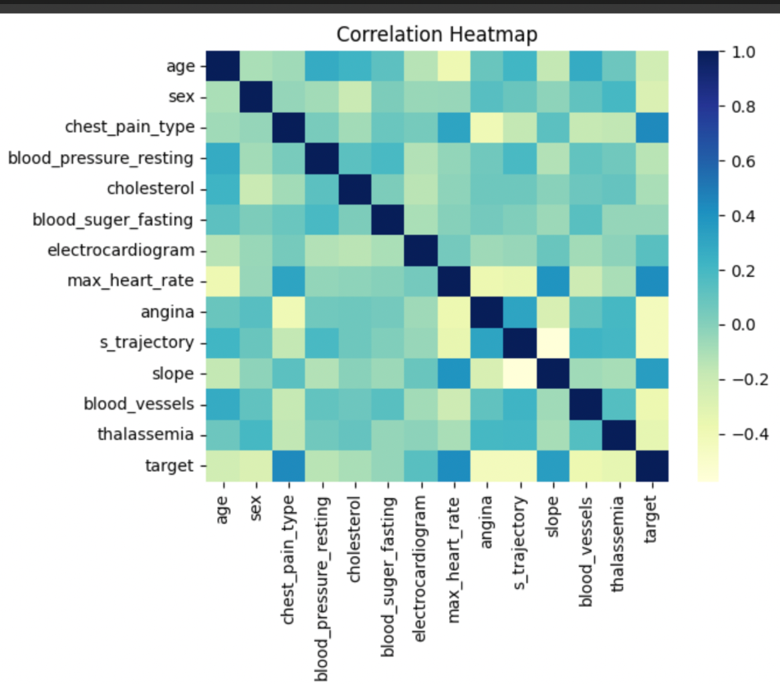
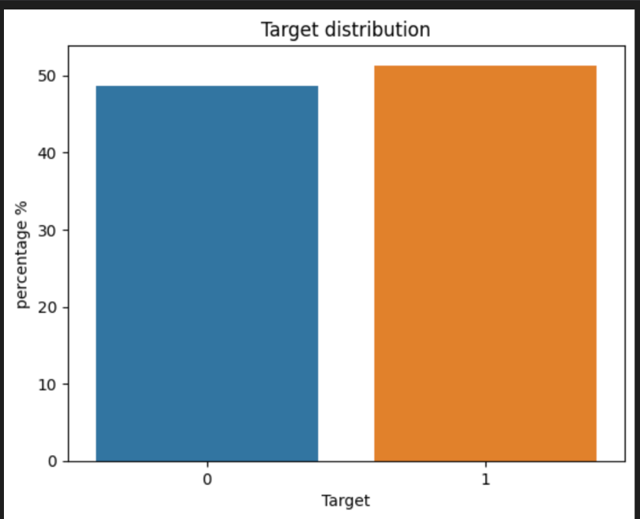
Figure 2:
Figure 3:
Figure 1:

Slide 8

Feature Extraction
Feature extraction simplies the dataset and captures the essential information
Principal component analysis (PCA) is used to reduce the dimensions of the dataset and create new features known as principal components.
The reduction of dimensions and subsequent reduction of noise and redundancy helps prevent overfitting, as demonstrated in Figure 5.

Slide 9

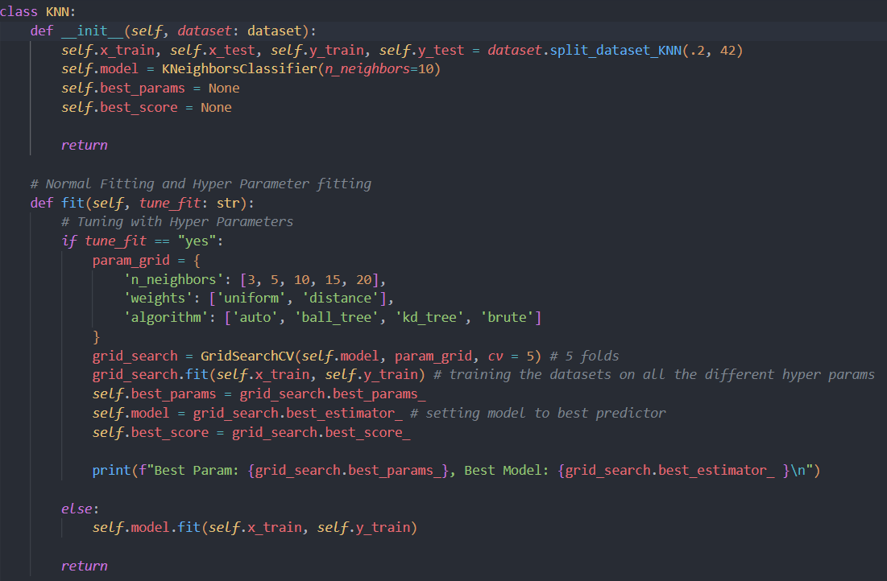
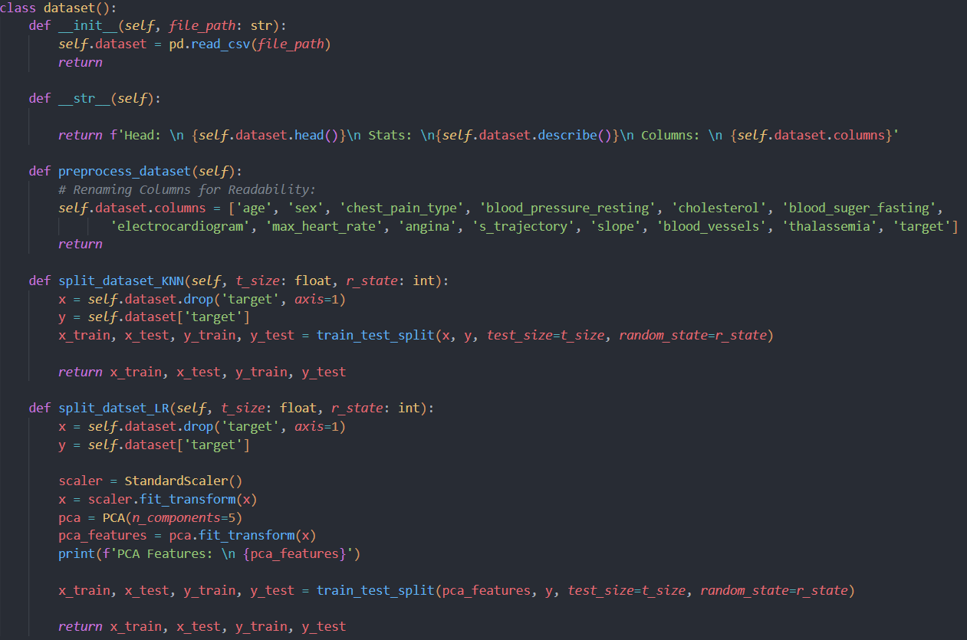
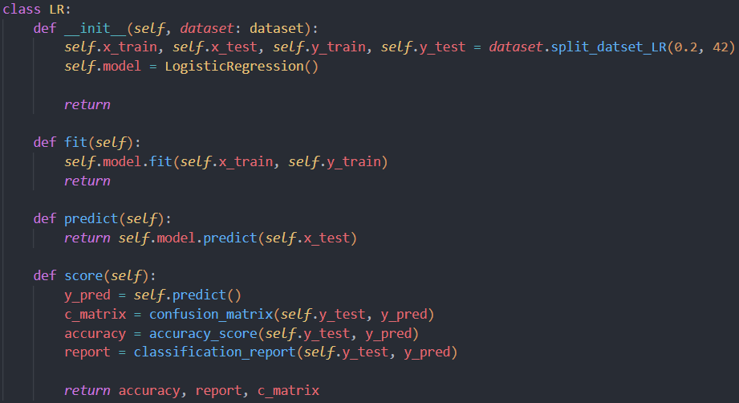
Methodology

Slide 10

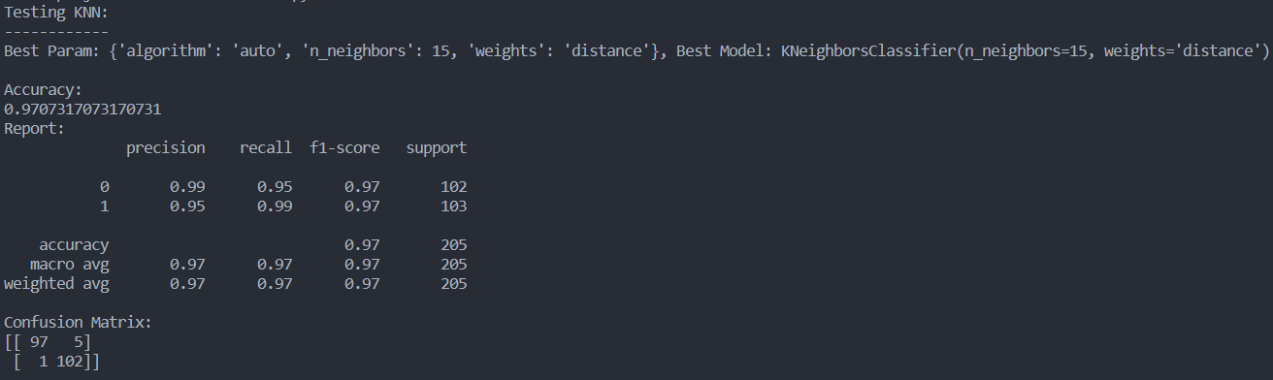
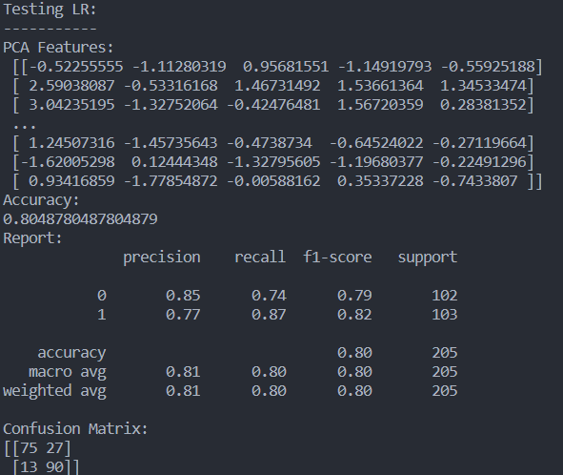
Results/Experimental Analysis:
KNN:
Logistic Regression:

Slide 11
Conclusion
K-Nearest-Neighbor is the better classifier for diagnosing heart disease based on the analysis conducted.
Hyper parameter tuning should be used to achieve the best possible accuracy when using KNN for heart disease diagnosis.
Future work could include expanding the project to a web application for predicting heart disease on live patient data.

